Slide 1
Progress Report 7-23-2024

Slide 2
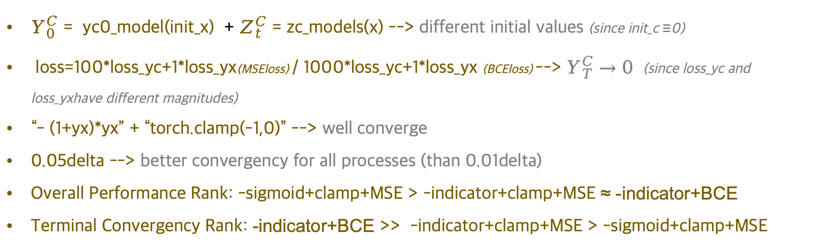
Reflection & Summary
$Y_{0}^{C}= yc0_model(init_x$) + $Z_{t}^{C}=zc_models(x)$ --> different initial values (since init_c ≡0)
loss=100*loss_yc+1*loss_yx(MSEloss) / 1000*loss_yc+1*loss_yx (BCEloss) --> $Y_{T}^{C}→0$ (since loss_yc and loss_yxhave different magnitudes)
“- (1+yx)*yx” + “torch.clamp(-1,0)” --> well converge
0.05delta --> better convergency for all processes (than 0.01delta)
Overall Performance Rank: -sigmoid+clamp+MSE > -indicator+clamp+MSE ≈ -indicator+BCE
Terminal Convergency Rank: -indicator+BCE >> -indicator+clamp+MSE > -sigmoid+clamp+MSE
Question:
dB1 == dB2 ?? --> so far the same dB is used (but differen init_x1 and init_x2)

Slide 3
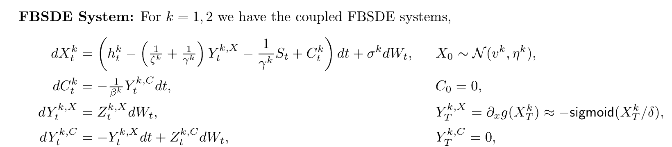
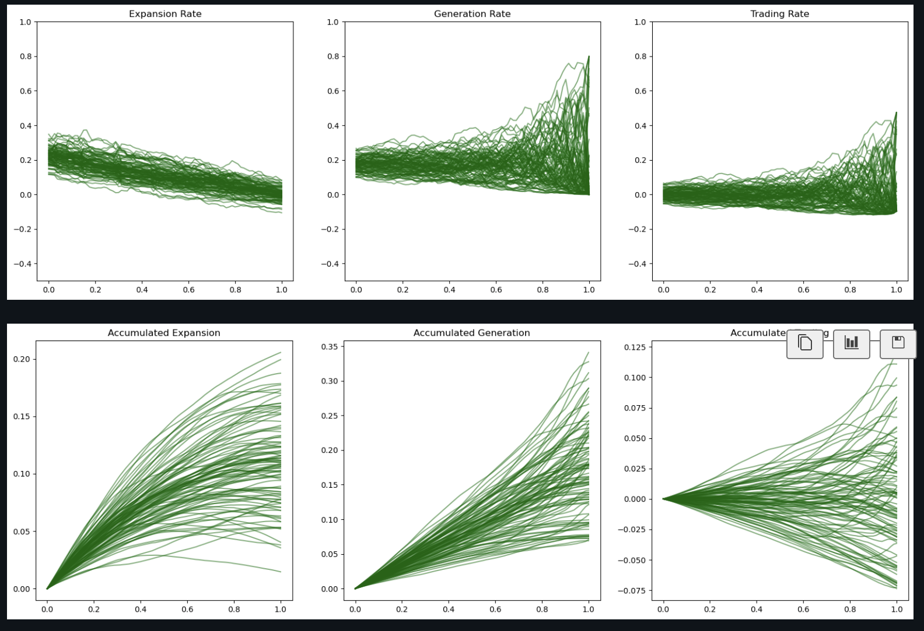
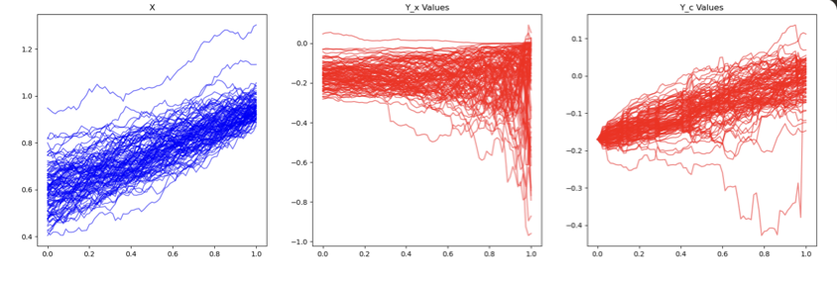
01 - change $\left\{\begin{aligned}Y_{0}^{C}= yc0_model(init_c) \\ Z_{t}^{C}= zc_models(c)\end{aligned}\right.$ --> $\left\{\begin{aligned}Y_{0}^{C}= yc0_model(init_x) \\ Z_{t}^{C}= zc_models(x)\end{aligned}\right.$

Slide 4
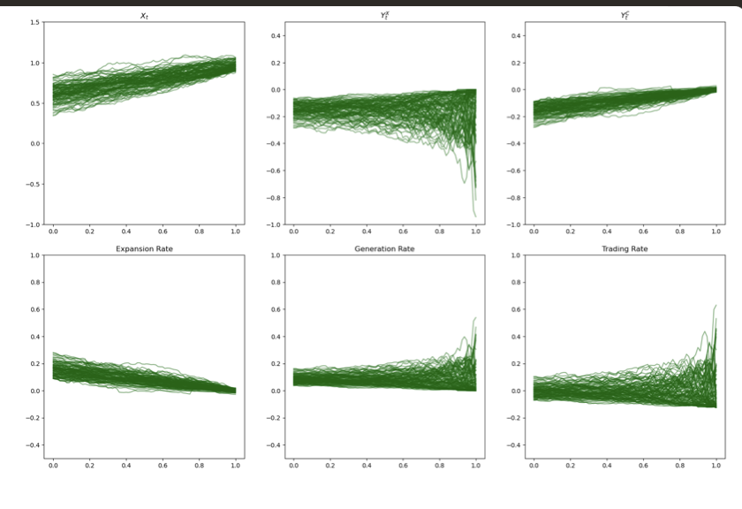
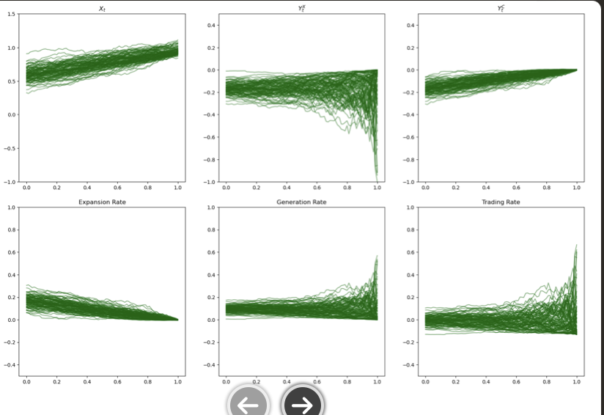
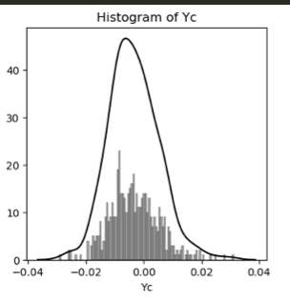
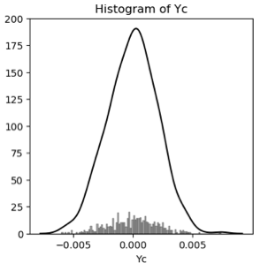
02 - Change: loss=100*loss_yc+1*loss_yx

Slide 5
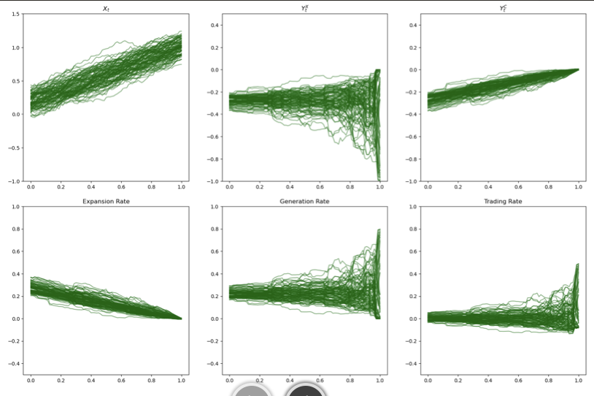
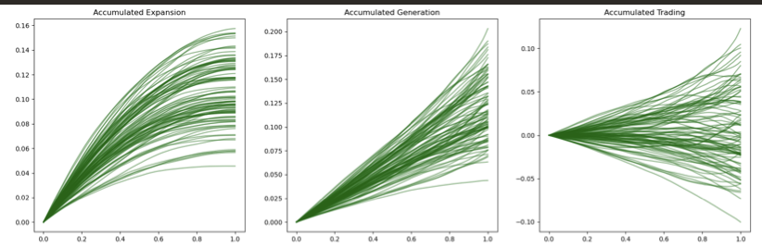
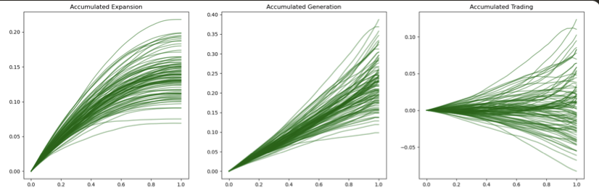
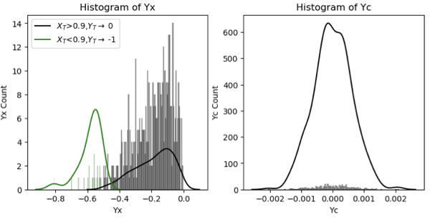
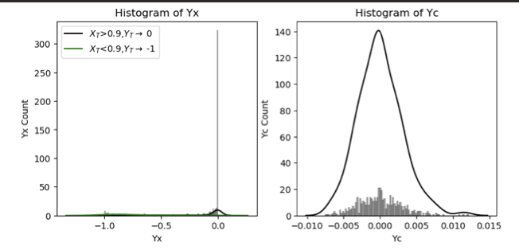
03 - Comparison
-sigmoid+clamp+MSE
-indicator+BCE

Slide 6
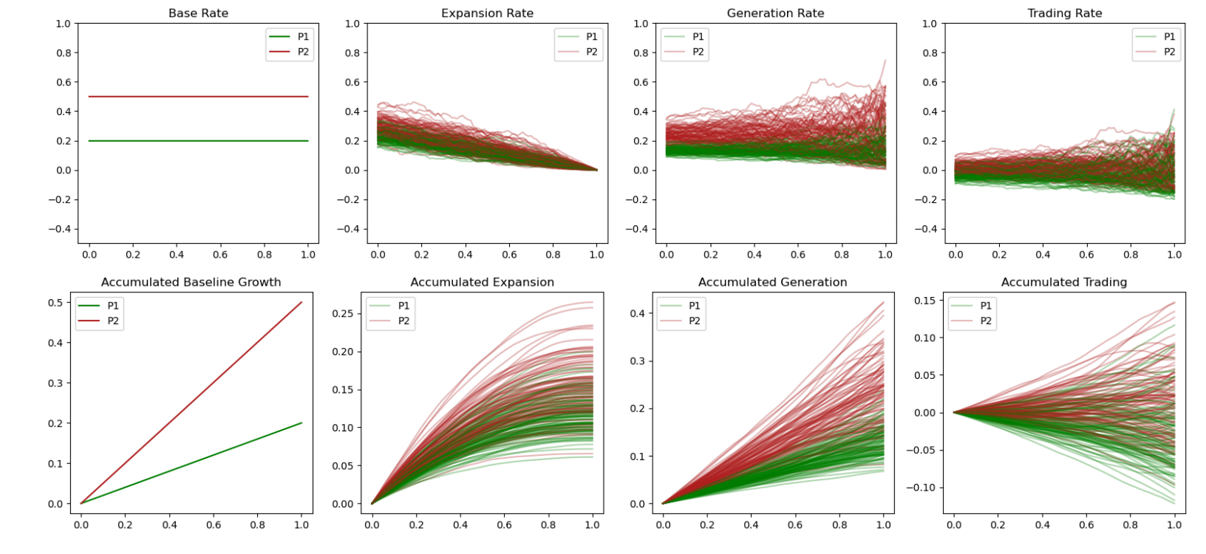
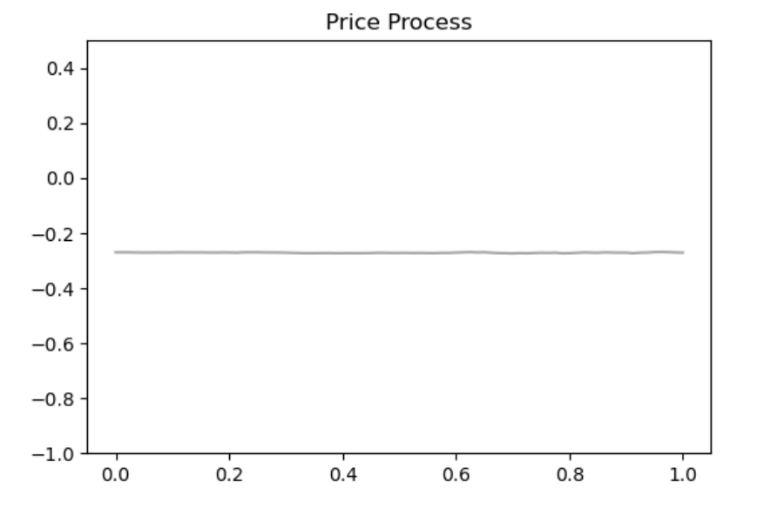
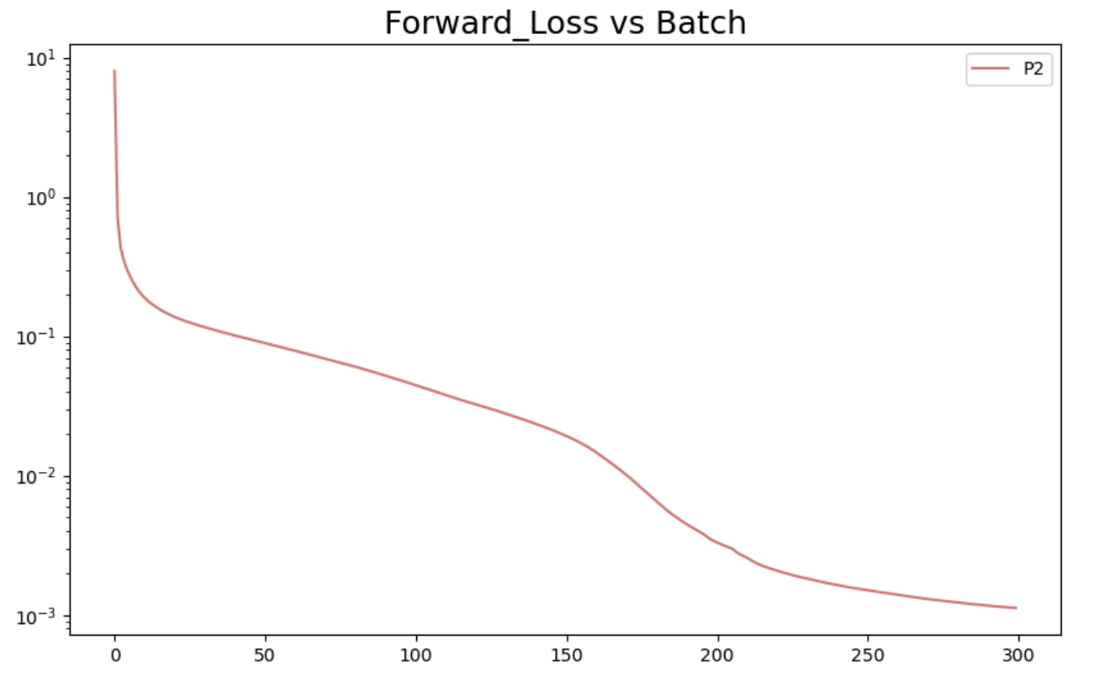
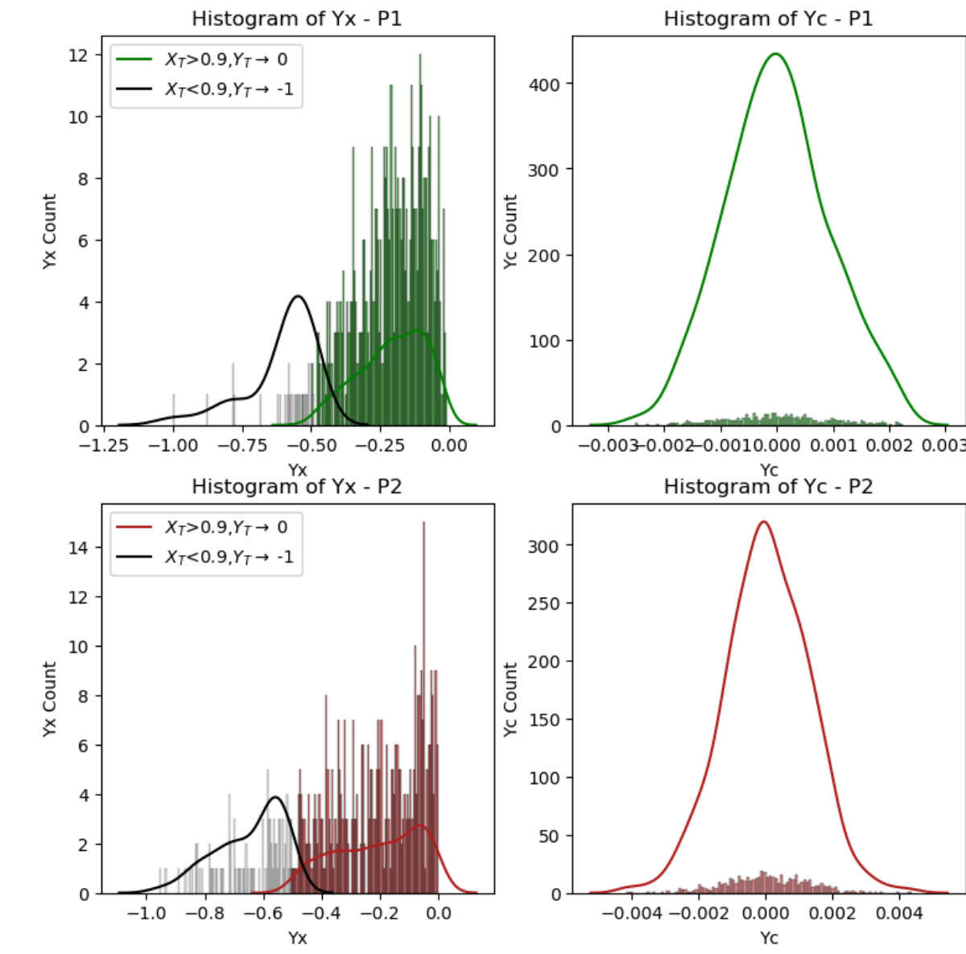
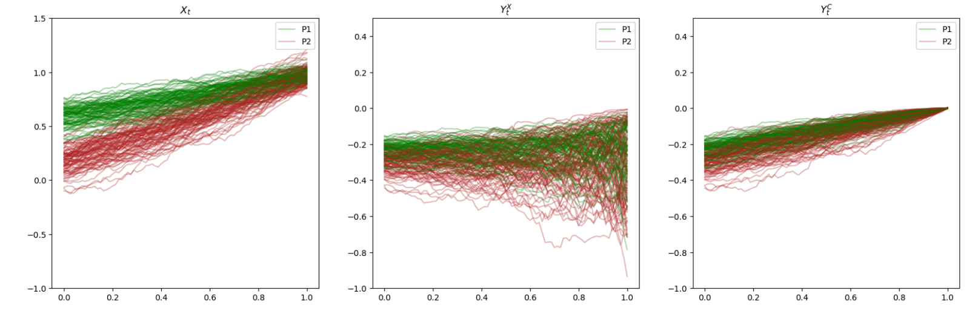
04 - 2 Populations: -sigmoid+clamp+MSE

